Slide 1

Education In America
Prepping For The Benjamins
Elizabeth Duenas
John Hawkins
Gustavo Mendoza

Slide 2


Slide 3
Data Sources
How did we get there?

Slide 4
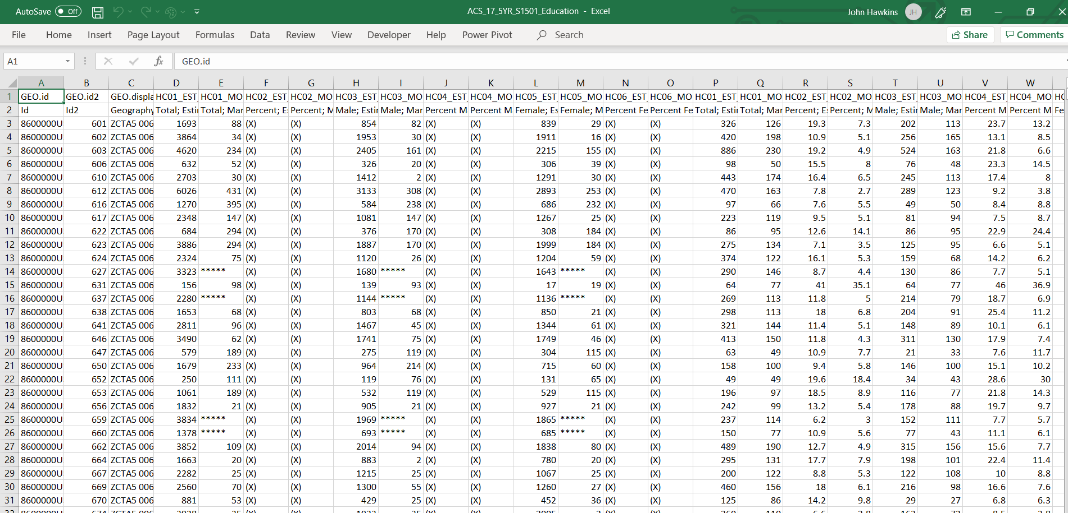
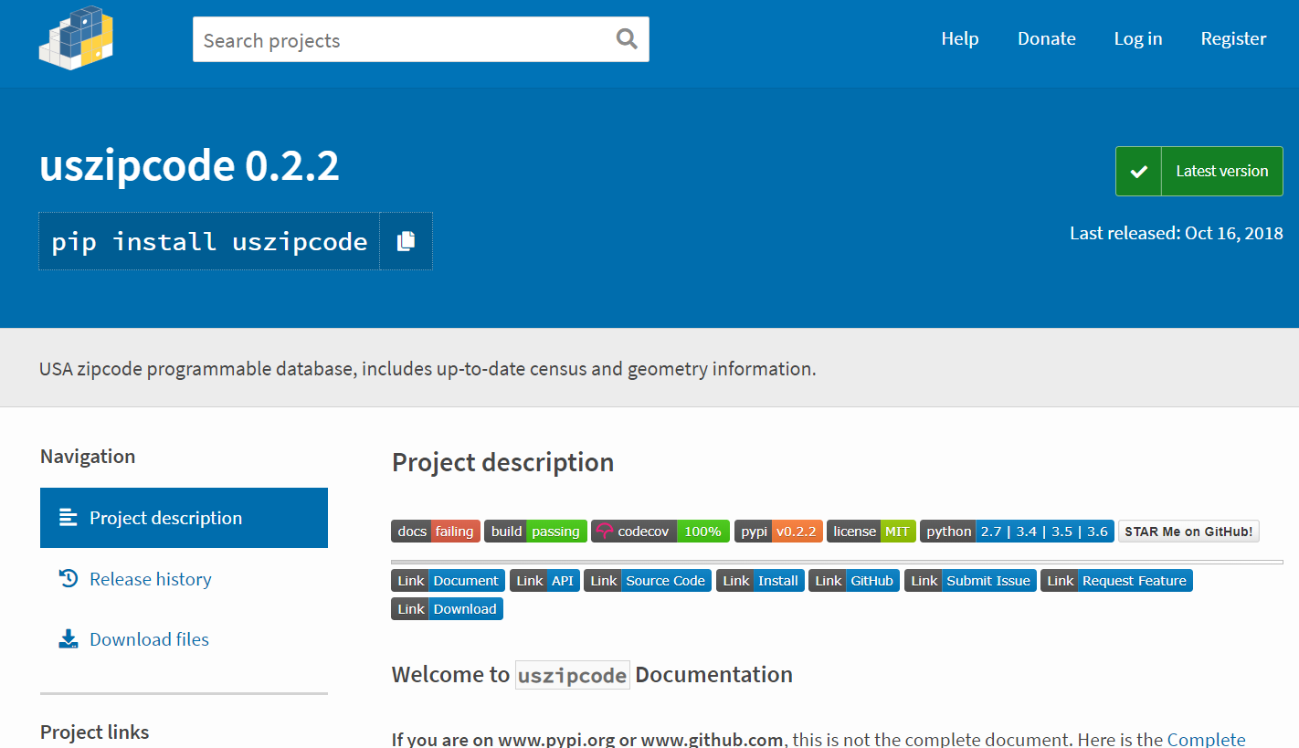
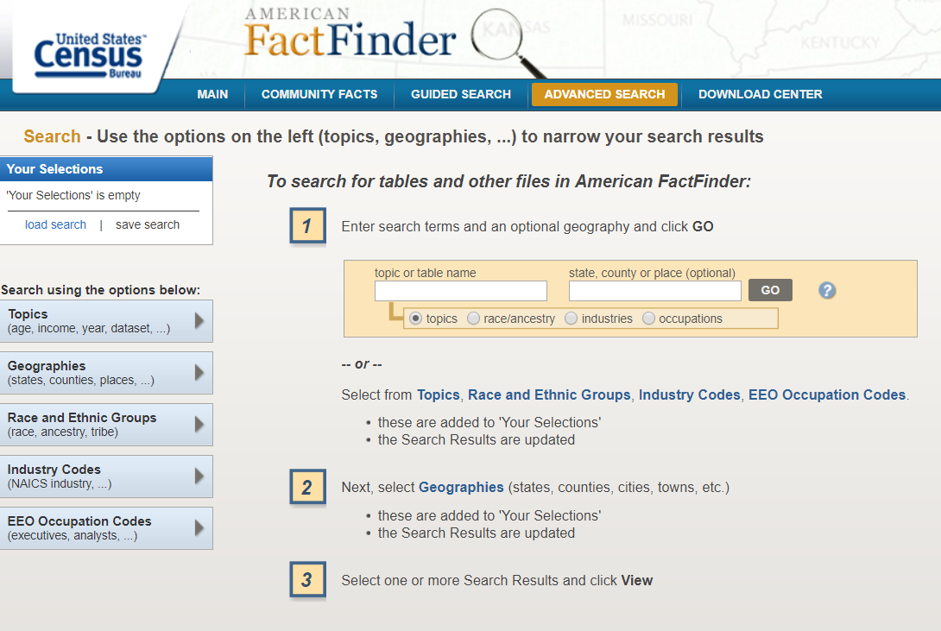
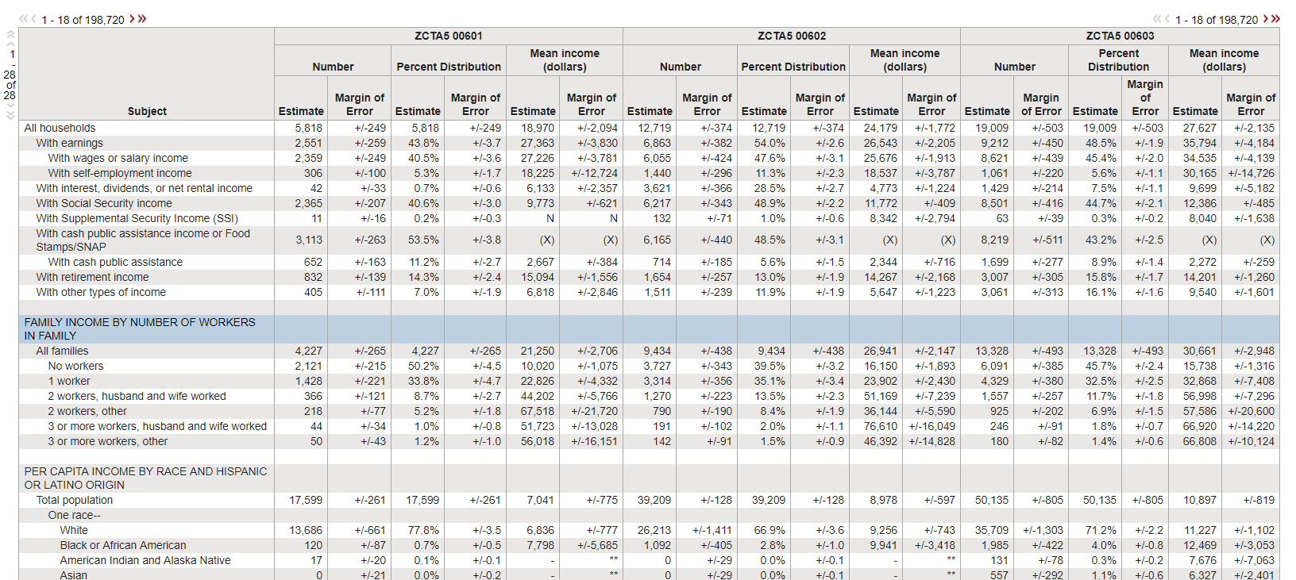
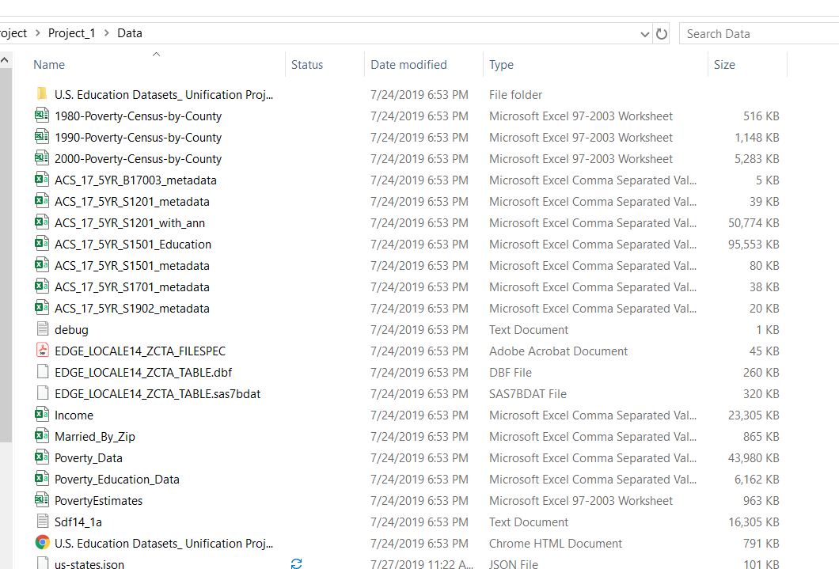
Data Sources
Notes:
John:
We pulled data from the US CENSUS webpage using the
“American Fact Finder” utility which allows download in csv files.
Then we started utilizing a Python Package named uszipcode 0.2.2
We then utilized the same API and wrapper we used for a class exercise which pulls data via the US census API.
and ____ API. The data cleaning process involved dropping N/A values and miscellaneous information recorded in various rows. After cleaning the data we focused our attention on Household Income, Poverty Rate, Educational Data, Zip Codes and State/County.

Slide 5
Data Sources
Census API Wrapper
Year – 2017
Data Set ACS5
American Community Survey
60 Months (5years) of collected data
Large Sample Size

Slide 6
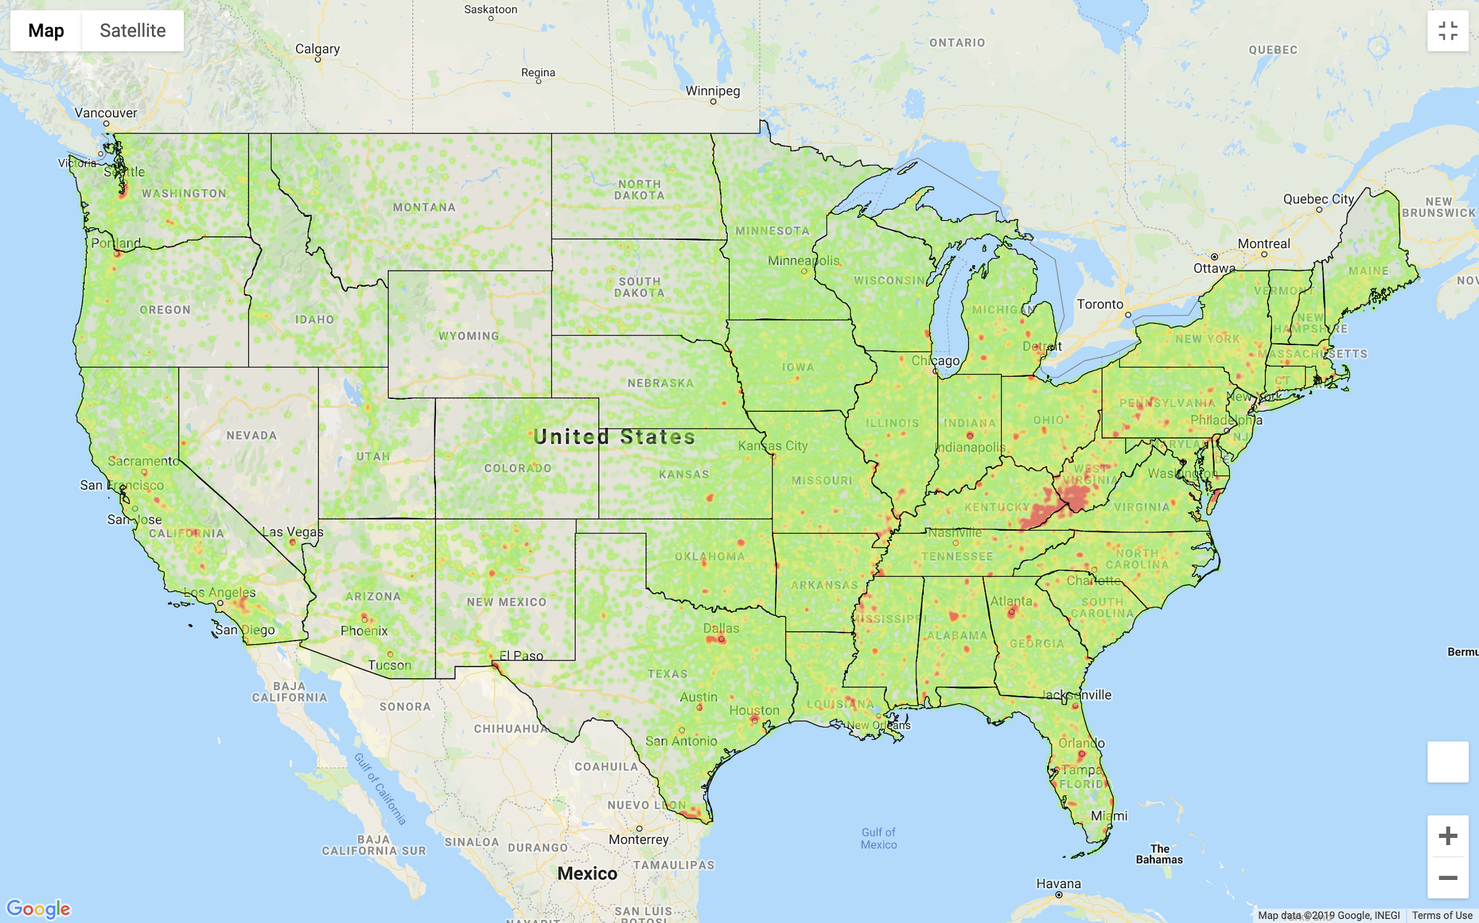
Poverty Rate around the United States

Slide 7
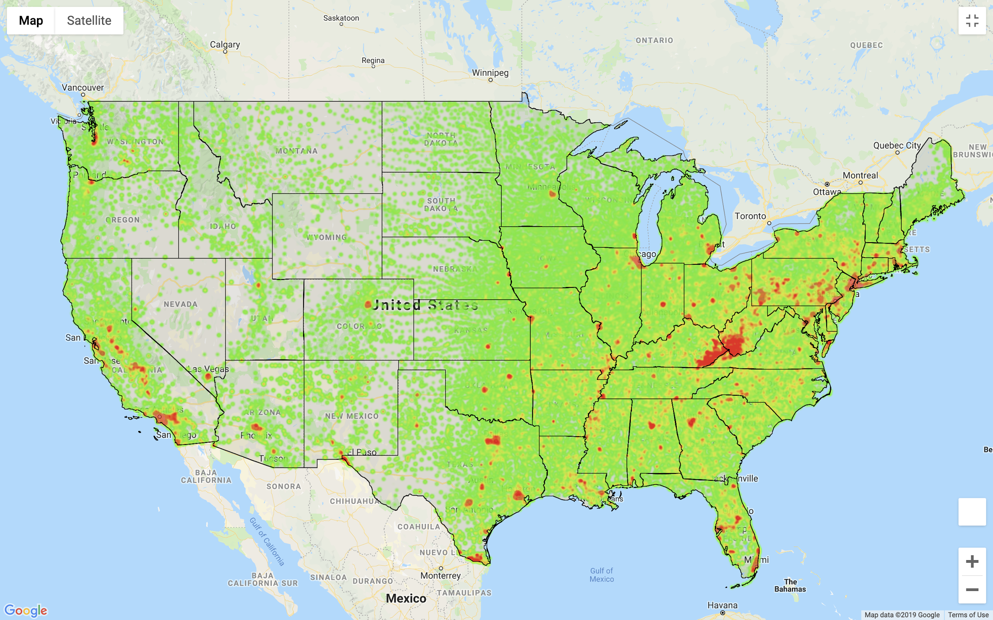
Rate of No High School Diploma

Slide 8
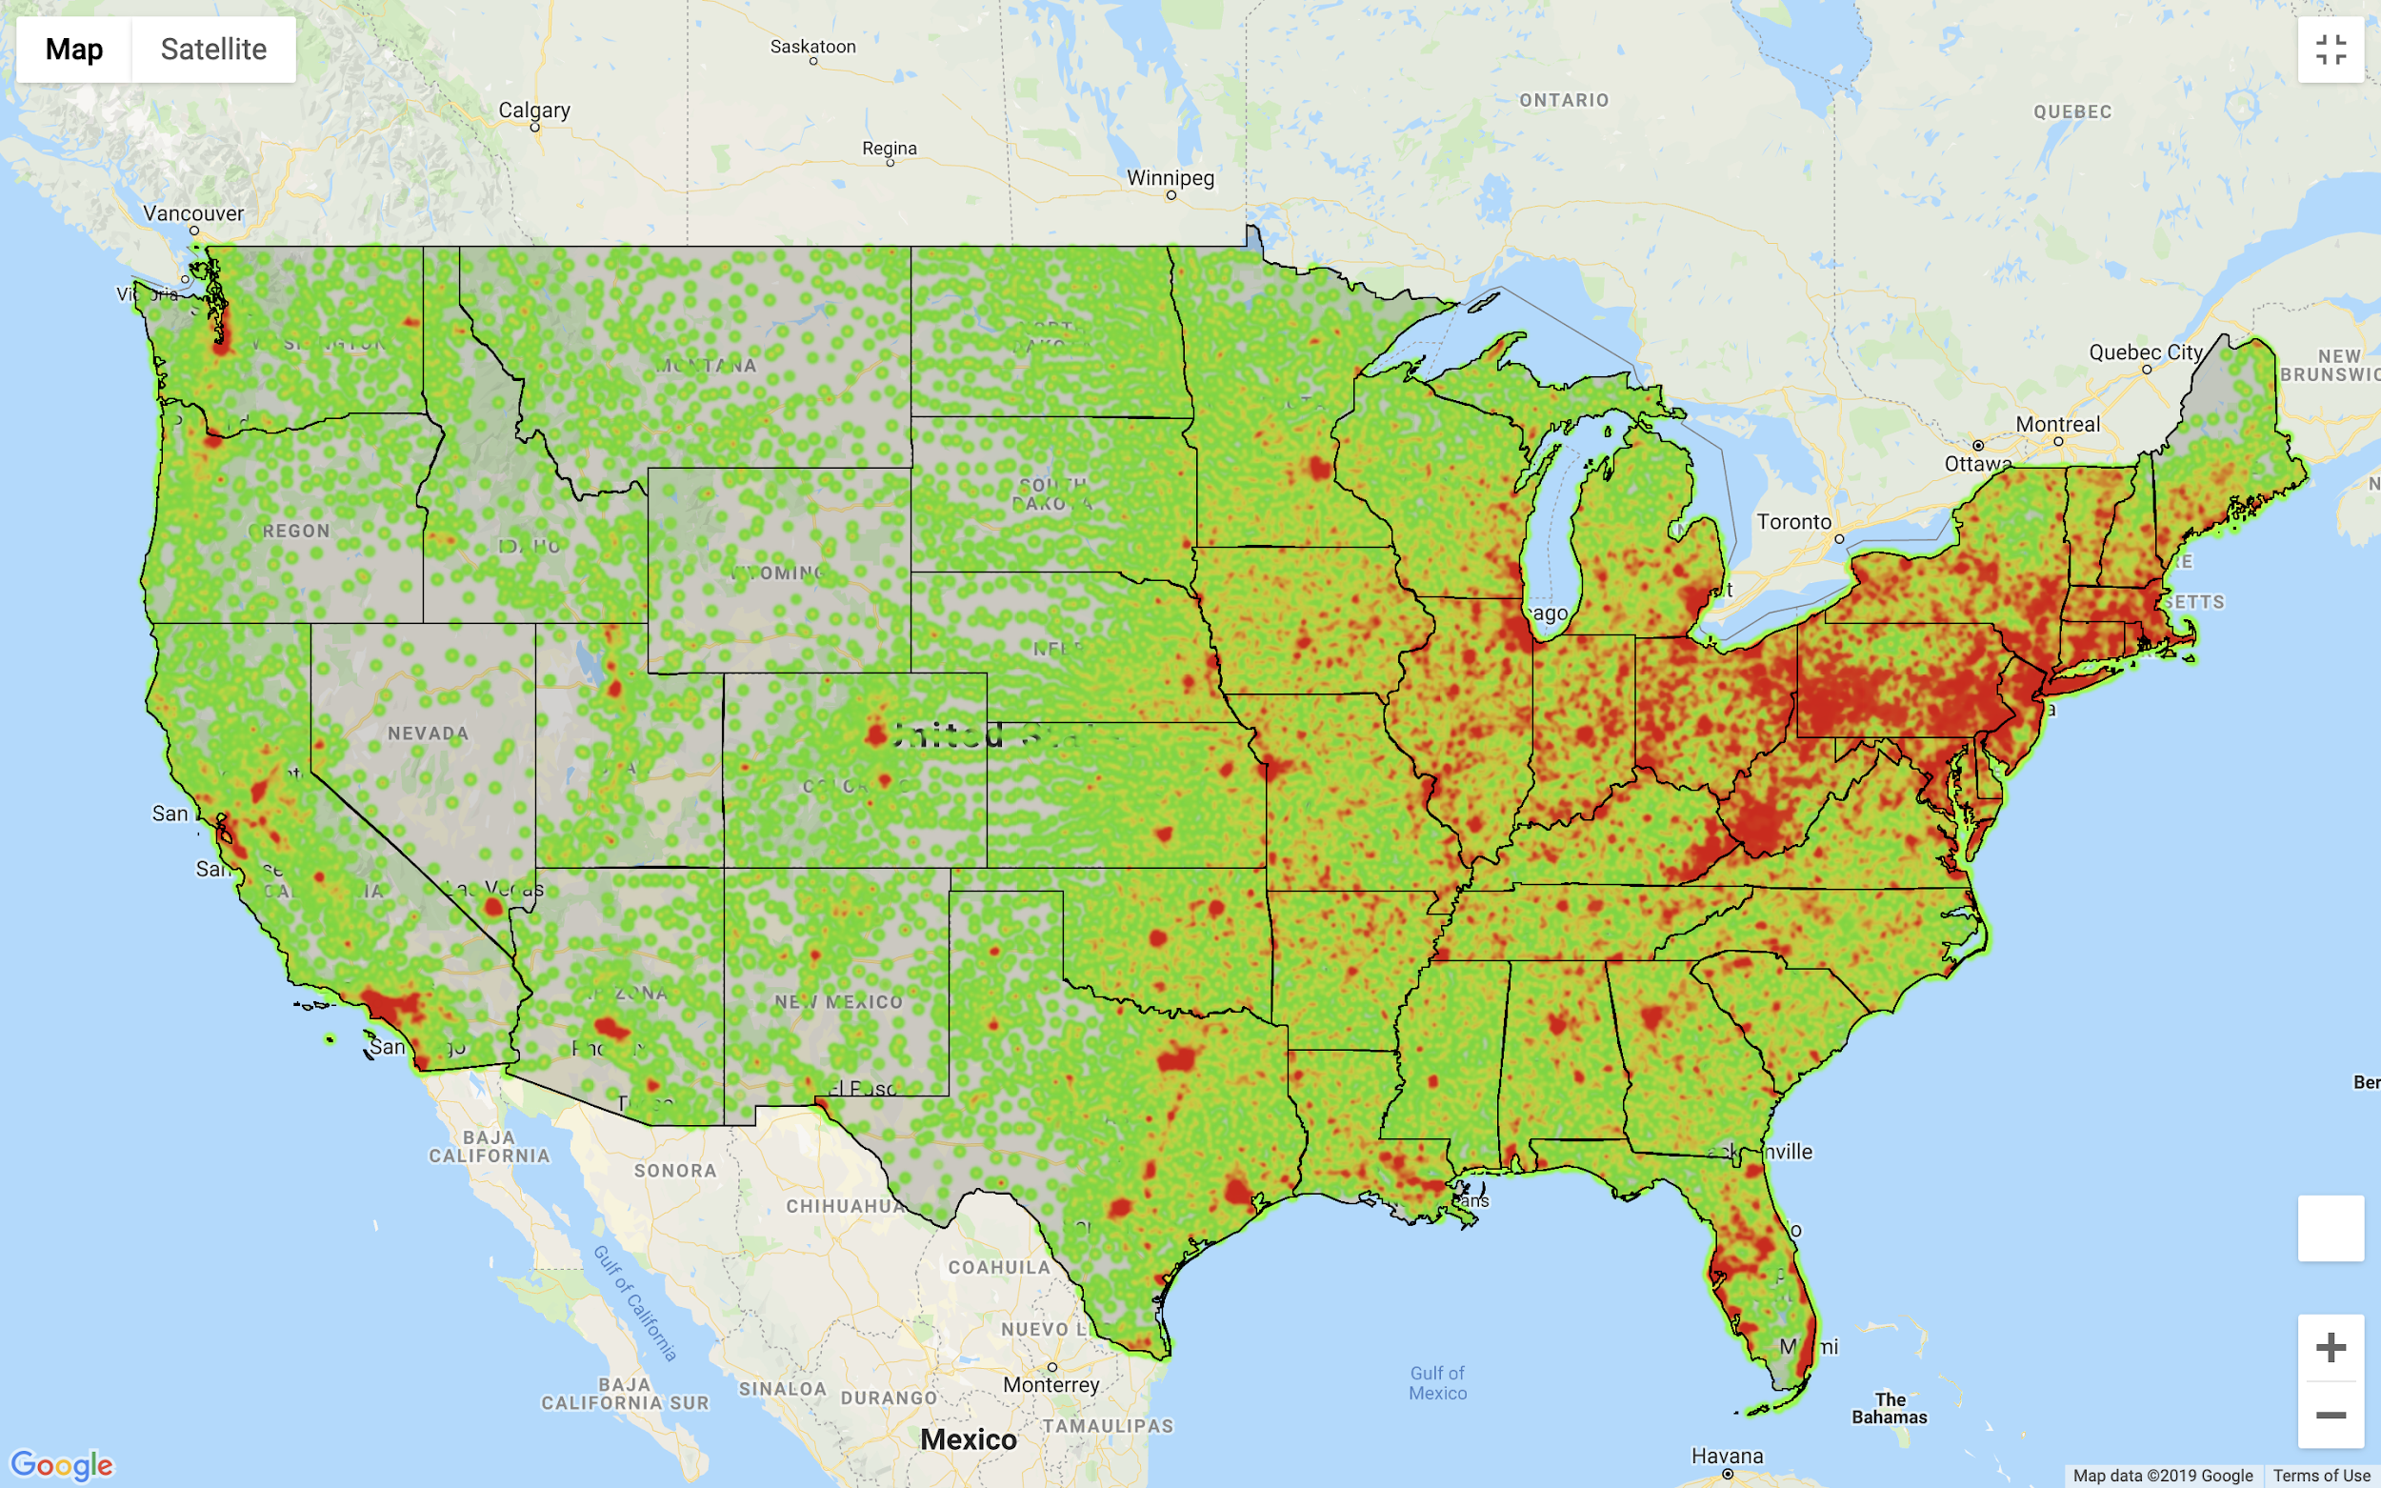
Rate of High School Diploma around the United States

Slide 9
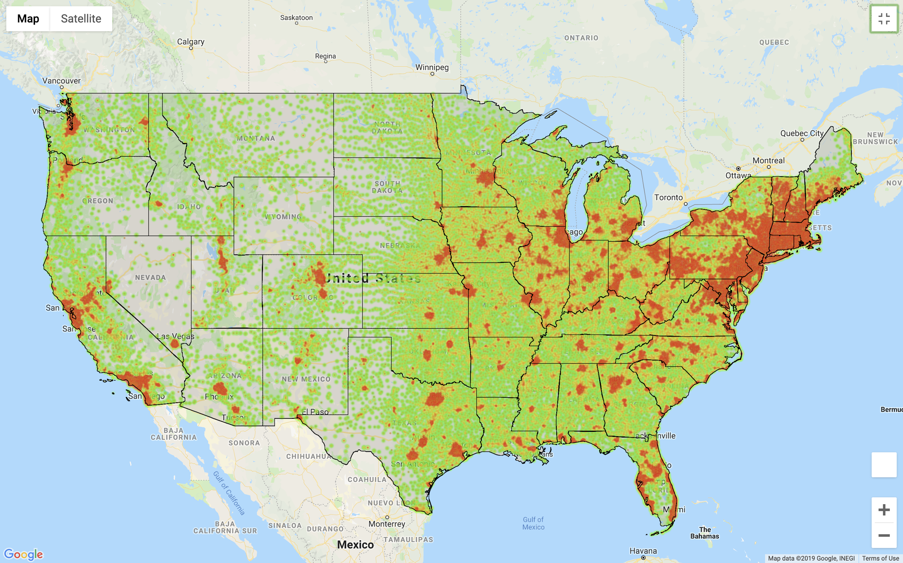
Rate of College degrees throughout the United States

Slide 10
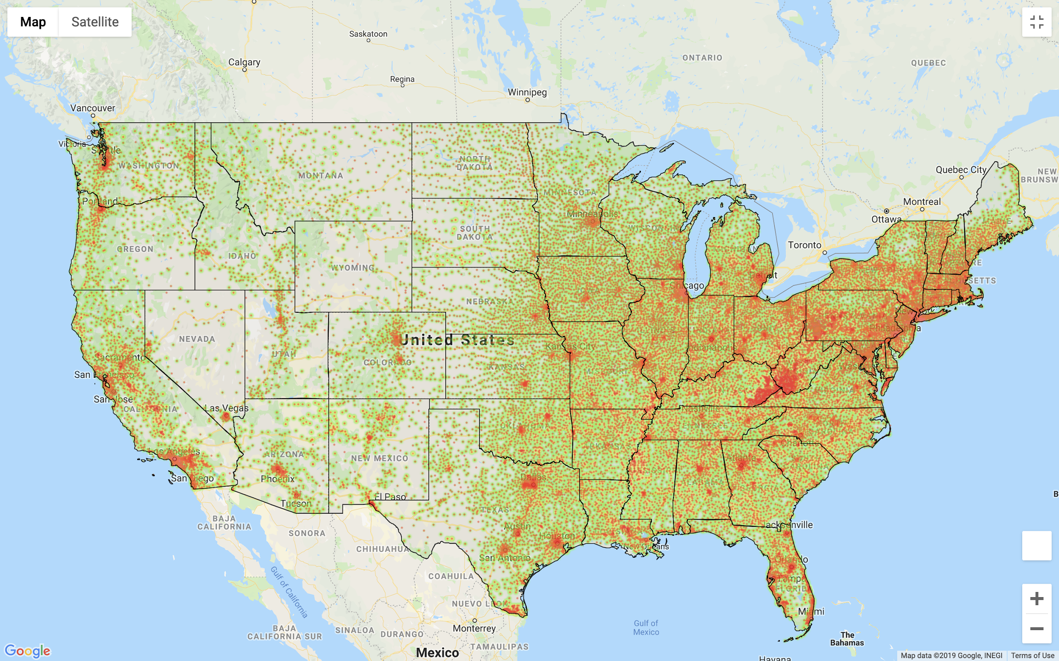
Income Per Capita around the US

Slide 11

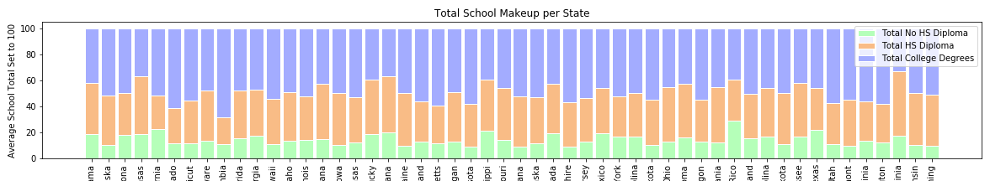
EDUCATION COMPILED PER STATE
Notes:
We wanted to get an overall sense of what was happening in the US. As such, we compiled the available data for no HS diploma, HS diploma and college degrees per state. We made them average to 100 in order to ensure we could view the data in a uniform way.
From this graph nothing stands out too much for you other than DC having a high percentage of College degrees.

Slide 12
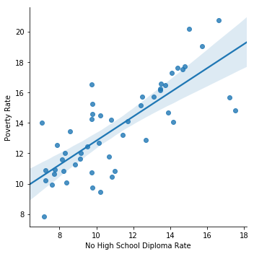
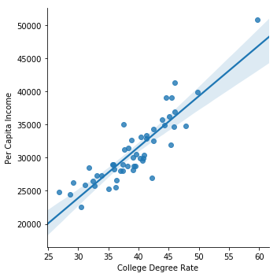
SCATTER PLOT
Notes:
Not having a High School Diploma and Poverty Rate have a strong uphill linear relationship with an R_value of .8307
Having a College Degree and Per Capita Income also have a strong uphill linear relationship with an R_value of .8336
Both have a strong uphill (positive) linear relationship but they are on opposite career paths and compared to poverty and average income.
Although we cannot make definitive conclusions, understanding that the higher education does correlate to a higher per capita income is enough stimulus to not be on the far left of the curve.

Slide 13
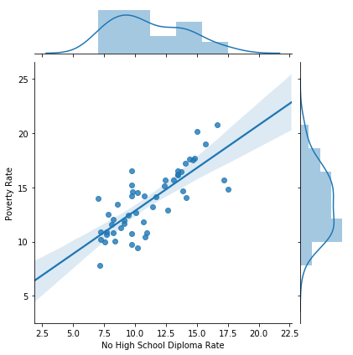
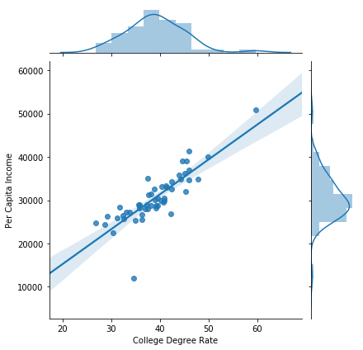
R value: 0.7805
P value: 1.4 e^-11
R value: 0.8878
P value: 3.9 e^-18

Slide 14
Looking Deeper
Who are the outliers?
Looking at County level data it appears there are Counties that have a higher income vs. No High School Diploma Rate. Why is that?
The assumption without digging deeper is that income is possibly more closely related to industry. For example, Midland County, Texas has an average per Capita income of $38,545 vs an all Counties average of $26,039.
Midland County was chosen as an example because it is known that this area is high affected by Oil and Gas industry, a historically well-paying industry.
It is believed with further research and data other pockets of high compensation with no College degree could be highlighted.

Slide 15

Conclusion

